Slide 1

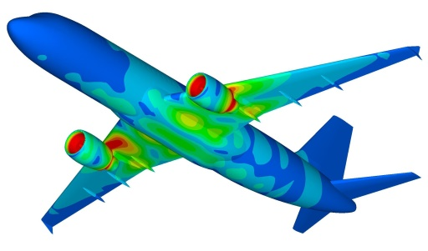
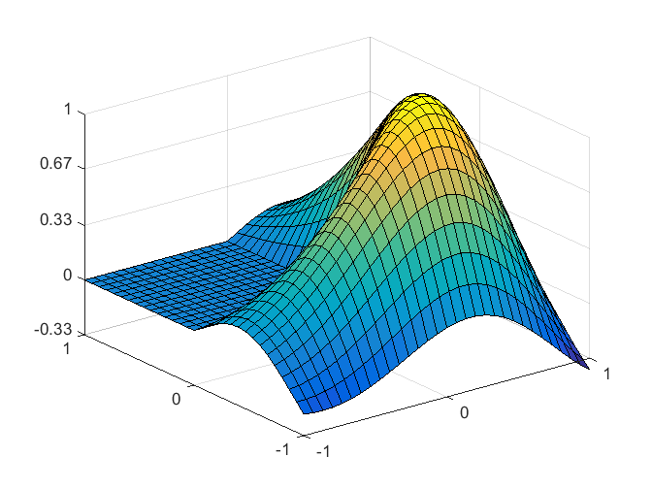
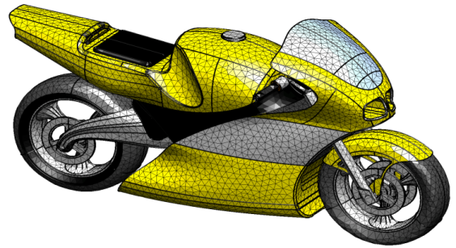
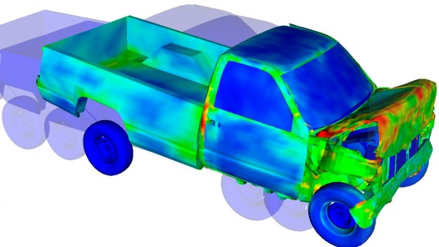
Eigen Value and Eigen Vectors
Dr. Himanshu Pathak
himanshu@iitmandi.ac.in

Slide 2
Introduction
Eigenvalue problems occur naturally in the vibration analysis of mechanical structures with many degrees of freedom.
Eigenvalue of smallest magnitude represents the natural frequency of given dynamic system.
In a eigenvalue problem [A] {x} = λ {x} ;
λ is eigenvalue of square matrix [A] and {x} is eigenvector for corresponding eigenvalue λ , provided x ≠ 0.

Slide 3
Finding Eigenvalue
[A]{x}= λ{x} can be written by A x – λ I x = 0 where λ x = λ I x
(A – λ I )x = 0 will have non-trival solution x ≠0, if and only if A – λ I is singular.
| A – λ I | = 0 -------------- characteristics equation
Solve the characteristic equation to find eigenvalue (λ).
Example 1: Eigenvalue for diagonal matrix
A – λ I=

Slide 4
Finding Eigenvalue Contd..
Example : Eigenvalue for triangular matrix
A – λ I=
Example: Eigenvalue for symmetric matrix
A – λ I=

Slide 5
Finding Eigenvalue Contd..
Example 4: Eigenvalue for non-symmetric matrix
Conclusions:
If A is triangular matrix (upper/lower/diagonal), eigenvalue will be diagonal elements.
If A is symmetric matrix of real elements, eigenvalue will be always real numbers.
If A is non-symmetric matrix, eigenvalue will be either real or complex conjugates.

Slide 6
Finding Eigenvectors
Example 1: Eigenvector for triangular matrix
[A]{x}= λ{x}
First eigenvalue Put this value in eigenvalue problem equation:
Second eigenvalue Put this value in eigenvalue problem equation:

Slide 7
Characteristics of Eigenvalue/Eigenvector
Eigenvector associated with distinct eigenvalue of symmetric matrix are always orthogonal.
If system exhibits same repeated eigenvalue, will always have one set of eigenvector.
If λ₁, λ₂,…. λ_{n} are eigenvalue of matrix A:
A^{T} will have same eigenvalues λ₁, λ₂,…. λ_{n} .
A⁻¹ will have eigenvalues λ₁⁻¹, λ₂⁻¹,…. λ_{n}⁻¹ .
A-αI will have eigenvalues λ₁ - α, λ₂ - α,…. λ_{n} - α .
A^{k} will have eigenvalues λ₁^{k}, λ₂^{k},…. λ_{n}^{k}.

Slide 8
Characteristics of Eigenvalue/Eigenvector
For any square matrix A, sum of eigenvalues will be equal to the sum of diagonal elements of A.
For any square matrix A, the product of eigenvalues will be equal to the determinant of A.

Slide 9
MATLAB© Script
Simplest MATLAB Program to find eigenvalue
clear all
clc
A = input(‘Enter system matrix = ’);% Define coefficient/system matrix
[n, m] = size(A); % Check the size of coefficient matrix
I = eye(n); % Define Identity matrix
syms y % Define y (eigenvalue) as variable
B = A - y*I; % Expression for Characteristic Equation
Ch = det(B) % Characteristic equation
Poly = input(‘enter coefficient of characteristic polynomial = ‘);
V = roots(Poly) % Find roots of polynomial as eigenvalue
Compare with inbuilt function
W = eig(A) % Find eigenvalue from inbuilt function
[X, V1] = eig(A); % Return X as eigenvector and V1 eigenvalue by inbuilt function

Slide 10
Finding Eigenvalue (Power Method)
Iterartive method to find largest Eigen value and Eigen vector
[A]{x}= λ{x} by initial guess of Eigen vector
Repeat [A]{x}= λ{x}; till λ^{(n)}≈ λ^{(n-1)} and x^{(n)}≈ x^{(n-1)}.
Example: Largest Eigenvalue for diagonal matrix
[A]{x} =
[A]{x⁰} =
[A]{x¹} =

Slide 11
Finding Eigenvalue (Power Method)
[A]{x²} =
[A]{x³} =
[A]{x⁴} =

Slide 12
MATLAB© Script
MATLAB Program to find eigenvalue by Power Method
clear all
clc
A = [5 7;3 2];
[n, m] = size(A);
xold =ones(n,1);
count =1;
tol =1e-3;
lamold = max(xold);
lam= 5;
maxitr = 1000;
while count < maxitr
x1 = A*xold;
lam = max(x1);
x = x1./lam;
if abs(lam-lamold)<tol
disp('Eigen value and Eigen vector calculated')
lam
x
count
return
else
lamold = lam;
xold = x;
count = count +1;
end
end

Slide 13
Finding Eigenvalue (Inverse Power Method)
Iterartive method to find smallest Eigen value and Eigen vector
[A]{x}= λ{x}; Multiply by [A]⁻¹
{x}= λ[A]⁻¹{x};
(1/ λ){x}= [A]⁻¹{x}
[A]⁻¹{x}=(1/ λ){x}
[B]{x}=(β){x}…………..Eq 1
here [B] =[A]⁻¹ and (β)=(1/ λ)
Apply Power method algorithm over equation (1)
Repeat [B]{x}= β{x}; till β^{(n)}≈ β^{(n-1)} and x^{(n)}≈ x^{(n-1)}.

Slide 14


THANK YOU
Questions??

